Slide 1
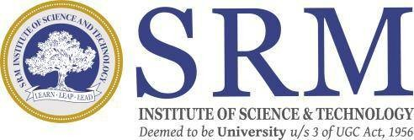
Real-Time Object Detection and Distance Mapping
SRM INSTITUTE OF SCIENCE AND TECHNOLOGY
SCHOOL OF COMPUTING
DEPARTMENT OF COMPUTING TECHNOLOGIES
18CSP109L- MAJOR PROJECT
TEAM : BATCH ID - CTB07234
Student 1: KINTHALI SAKETH (RA2111003011009)
Student 2: PUDI SAI KRISHANA (RA2111003011033)
Project Guide Name: Dr. V. RAGHAVENDRA
Designation: ASSISTANT PROFESSOR
Department: COMPUTING TECHNOLOGIES

Slide 2
Table of Contents
Abstract
Problem Statement
Introduction
Real-Time Example
Architecture Diagram
Scope and Motivation
Objectives
Yolov8
Literature Survey
Outcome
Conclusion

Slide 3
Abstract
The "Real-Time Object Detection and Distance Mapping" project is a smart vision system that detects objects and estimates their distance from a camera. It uses the YOLOv8 model for fast and accurate detection in images and video streams.
The system includes modules for static image detection, real-time webcam tracking, and distance-based alerts. It features bounding box detection, center point tracking, and pixel-to-meter conversion with visual overlays.
Audio feedback warns users when objects are too close, helping improve safety and accessibility. Performance is optimized using frame resizing, multithreading, and FPS tracking for smooth operation.

Slide 4
Problem Statement
In today’s technology-driven world, object detection plays a crucial role in systems like autonomous vehicles, safety mechanisms, and assistive devices. Models like YOLO have advanced real-time object identification but fall short in one key area: estimating the distance to detected objects. This lack of spatial awareness limits their effectiveness in real-world applications.
For example, self-driving cars must not only recognize nearby vehicles or pedestrians but also determine their exact distance to prevent collisions. Similarly, assistive tools for visually impaired individuals could become significantly more effective by providing proximity-based alerts. Accurate distance information can enhance user safety and mobility.
In industrial settings, knowing how close machinery or personnel are to each other is vital for avoiding accidents and improving workflow. However, most current systems cannot measure object distances in real time. This gap reduces their potential, especially in scenarios where quick and accurate decisions are critical.

Slide 5
Introduction
Computer vision has advanced with deep learning models like YOLO, enabling fast and accurate object detection in real time.
Traditional object detection models lack the ability to estimate how far objects are from the camera. The "Real-Time Object Detection and Distance Mapping" project combines YOLOv8 with distance estimation to solve this limitation.
YOLOv8 is a lightweight, high-speed model suitable for real-world applications even on standard hardware. The system takes input from videos, webcams, or static images and detects objects using YOLOv8. It estimates distances using known object sizes, pixel measurements, and camera parameters like focal length.
Pixel-to-meter scaling and geometric calculations are used for accurate distance mapping. A text-to-speech module provides real-time audio alerts when objects are close, improving safety. Core features include bounding box detection, centroid tracking, frame resizing, and FPS monitoring.

Slide 6
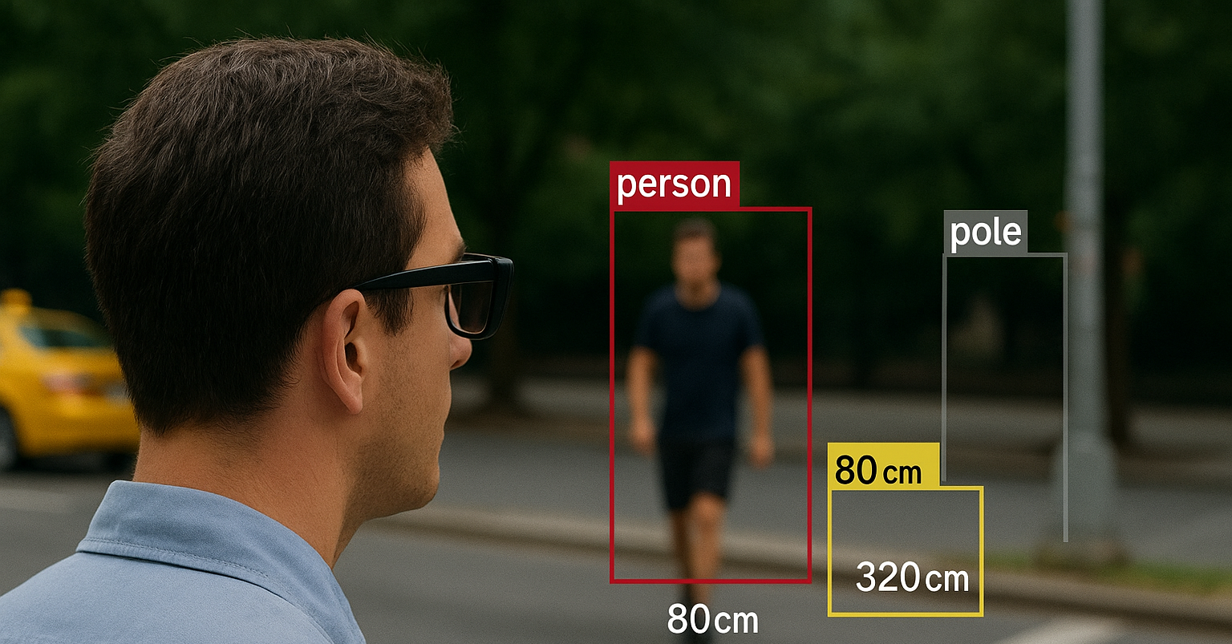
Real-Time Example
A visually impaired person uses a wearable camera connected to the system while walking in a busy street. As the camera captures video, YOLOv8 detects nearby objects like vehicles, people, or poles. The system calculates how far these objects are from the user using the camera's focal length and object size. When someone or something is within a close distance (e.g., below 50cm), the system instantly uses text-to-speech to say, “Unsafe”, helping the person avoid a collision.

Slide 7
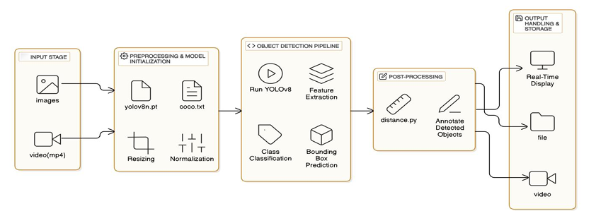
Architecture Diagram

Slide 8
Scope and Motivation
SCOPE:
The scope of the "Real-Time Object Detection and Distance Mapping" project focuses on creating a system that can detect objects in real time and estimate their distance from the camera.
By using the YOLOv8 deep learning model, the system will identify objects like people, vehicles, or obstacles and calculate their distance through methods like pixel-to-meter scaling. This is particularly useful for applications like autonomous driving, robotics, and assistive technologies.
The system will also provide auditory feedback for visually impaired individuals, alerting them to nearby objects and helping them navigate more safely. This aspect of the project aims to enhance accessibility and independence for those with disabilities.
Motivation:
The motivation behind the "Real-Time Object Detection and Distance Mapping" project stems from the growing need for advanced, accessible technologies that enhance safety, improve situational awareness, and provide critical assistance in real-time.
With the rise of autonomous systems, smart devices, and the need for safer environments, this project seeks to bridge the gap by offering a solution that not only detects objects accurately but also calculates their distance, providing immediate feedback to users. Whether it's for autonomous driving, aiding visually impaired individuals, or ensuring safety in industrial settings, the system aims to create a safer, more efficient, and responsive interaction with the environment.

Slide 9
Objectives
Real-Time Detection: The system will process and detect objects in real-time, ensuring quick and accurate identification of various objects in the environment.
Object Classification: It will classify detected objects, such as pedestrians, vehicles, and obstacles, enabling intelligent decision-making based on object type.
Distance Measurement: By implementing pixel-to-meter scaling and focal length estimation, the system will calculate the exact distance of each detected object from the camera or sensor.
Visual Feedback: The system will provide clear visual feedback, marking detected objects with bounding boxes on the live video feed for immediate recognition.
Auditory Feedback: When objects are detected to be too close, the system will deliver auditory feedback via text-to-speech, alerting users to potential hazards.
Use Cases: The system will be adaptable for real-world applications such as autonomous vehicles, navigation assistance for the visually impaired, and improved safety protocols in high-risk industrial environments.
Device Optimization: To ensure smooth performance across various devices, the system will dynamically resize video frames and use multithreaded processing to maintain speed and efficiency.
User Safety: By providing both visual and auditory cues, the system will enhance safety by allowing users to react to their surroundings more effectively, especially in situations where proximity to objects is crucial.

Slide 10
Why Yolov8?
Lightning-Fast Detection with Precision
YOLOv8 delivers real-time object detection with impressive accuracy, even on lightweight devices. Its speed and precision make it ideal for scenarios where quick decision-making and reliable results are critical like in robotics or assistive systems.
Smart and Scalable Architecture
Built with an advanced, decoupled head and modern backbone, YOLOv8 achieves better learning efficiency and cleaner predictions. Whether you're working on small-scale devices or powerful GPUs, it scales beautifully.
Multi-Tasking Made Easy
Beyond object detection, YOLOv8 supports instance segmentation, pose estimation, and classification giving your system the flexibility to evolve and handle more complex spatial understanding in the future.
Perfect Partner for Distance Mapping
YOLOv8's accurate bounding boxes and object coordinates integrate smoothly with depth sensors, stereo cameras, or monocular distance algorithms enabling reliable, real-time distance estimation for every detected object.

Slide 11
Literature Survey
S.No | Title of the Paper | Year | Journal/Conference | Inferences
1. | Object Detection in Adverse Weather Conditions for Autonomous Vehicles | 2024 | Google Scholar | Deep learning models combined with sensor fusion can improve object recognition accuracy in rain, fog, and snow.
2. | Sensor and Sensor Fusion Technologies for Autonomous Vehicles | 2021 | Google Scholar | Integration of multiple sensors is critical for enhancing vehicle perception; real-time data processing and cost constraints remain a challenge.
3. | The Convergence of Artificial Intelligence and Mechatronics in Autonomous Driving | 2024 | Google Scholar | AI plays a significant role in decision-making, path planning, and obstacle avoidance.
4. | Localization for Self-Driving Vehicles Using Deep Learning Networks and RGB Cameras | 2023 | Google Scholar | Deep learning-based localization outperforms traditional GPS methods in urban environments.
5. | AI-Based Sensor Fusion for Traffic Surveillance in Autonomous Vehicles | 2023 | Google Scholar | Proposed AI-based method for detection and localization using traffic cameras improves vehicle tracking accuracy.

Slide 12
Outcome
Real-Time Object Detection and Distance Mapping: The system provides immediate identification and distance estimation of objects in the environment, enabling effective spatial awareness.
Enhanced Safety and Accessibility: By offering visual and auditory feedback, the system alerts users to potential hazards, particularly useful in autonomous driving and for visually impaired individuals.
Optimized Performance Across Devices: The system maintains smooth operation on various hardware by utilizing dynamic video resizing and multithreaded processing, ensuring efficiency even on less powerful devices.
Versatile Application and Scalability: The solution can be adapted for multiple use cases, from autonomous vehicles to industrial safety, and can scale to integrate with different sensors and devices.

Slide 13

Conclusion
The "Real-Time Object Detection and Distance Mapping" system leverages the power of YOLOv8 to provide accurate and immediate detection of objects and their distances in real-time. By combining visual and auditory feedback, the system ensures enhanced safety and accessibility for users in various applications, such as autonomous driving and assisting the visually impaired. Its optimized performance guarantees smooth operation across different devices, making it scalable and adaptable to a range of real-world environments. Ultimately, this project aims to improve situational awareness, safety, and efficiency, offering valuable solutions for both everyday and specialized scenarios.

